Slide 1




NEXT GEN EMPLOYABILITY PROGRAM
Creating a future-ready workforce
Team Members
College Name
Student Name :Abirami M
Student ID :au912421104002
Shanmuganathan Engineering College

Slide 2

CAPSTONE PROJECT SHOWCASE
Project Title
Voting Application using Django Framework-ABIRAMI M-(4047,SEC)
Abstract | Problem Statement | Project Overview | Proposed Solution | Technology Used | Modelling & Results | Conclusion

Slide 3

Abstract : Django Web Application Voting System
The Django web application voting system is a robust online platform designed to streamline the voting process while maintaining security and accessibility. Leveraging the Django framework, this system provides a user-friendly interface for both voters and administrators, enabling efficient management of elections. The system typically includes features such as user authentication, candidate registration, ballot creation, voting mechanisms, and result tabulation.
Source :

Slide 4
Problem Statement
The problem statement for a Django web application voting system would typically address the challenges and requirements associated with developing such a system.
To address these issues, there is a need for a robust online voting system. Such a system should provide a user-friendly interface for both voters and administrators, ensure the integrity and security of the voting process, and adhere to legal and regulatory requirements.
Source :

Slide 5
Project Overview
Application name : Voting Application
Category : Web application
Features :
1. user authentication.
2.candidate registration.
3.Ballot creation.
4.voting mechanisms
Technologies Used:
Django Framework to create a back-end and handle database.
HTML,CSS and JavaScript to create font-end and handle it
Source :

Slide 6
Proposed Solution
.
Voter Registration: A feature allowing eligible voters to register their details securely, including personal information and verification documents. Administrators may approve or verify registrations.
Candidate Registration and Management: Functionality enabling candidates to register for elections, submit their profiles, photos, and other relevant information. Administrators can manage candidate listings and verify qualifications.
Ballot Creation: Administrators can create electronic ballots containing candidate names, issue propositions, and other relevant voting options. They can customize ballots for different elections or constituencies.
Result Tabulation: Automated tabulation of votes to determine the outcome of the election. This feature may include real-time reporting of results and graphical representation for easier understanding.
Source :

Slide 7
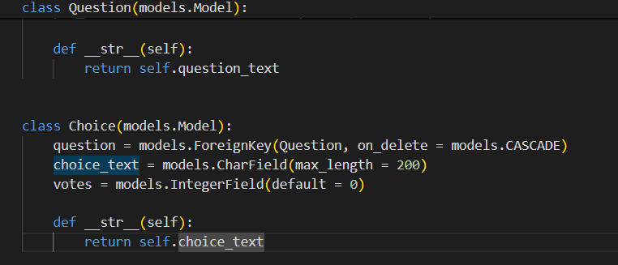
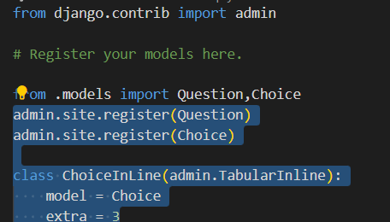
Models.py
Admin.py
Source :

Slide 8
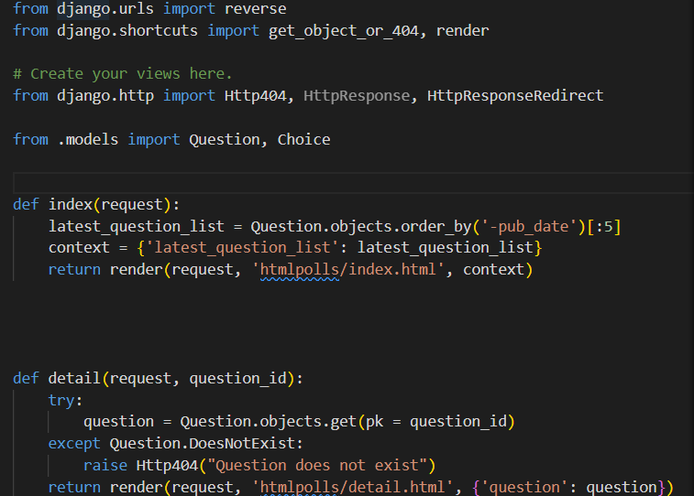
Views.py
Source :

Slide 9


Technology Used
Front-end
Back-end
Source :

Slide 10
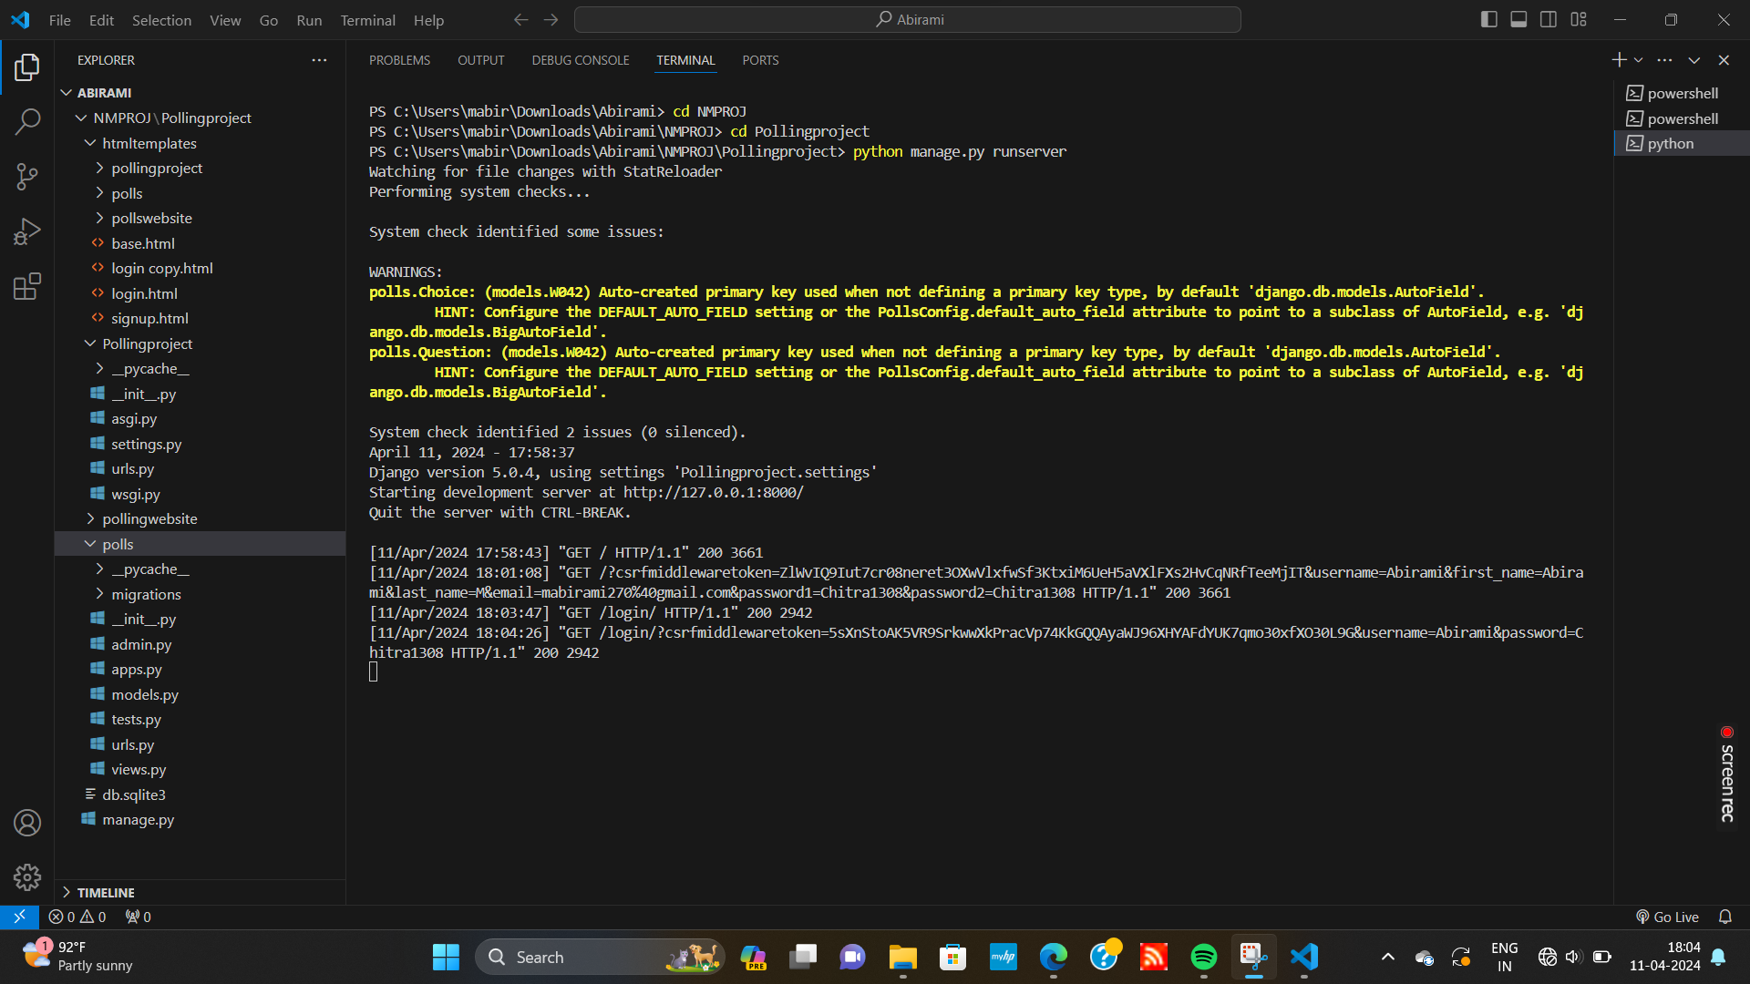
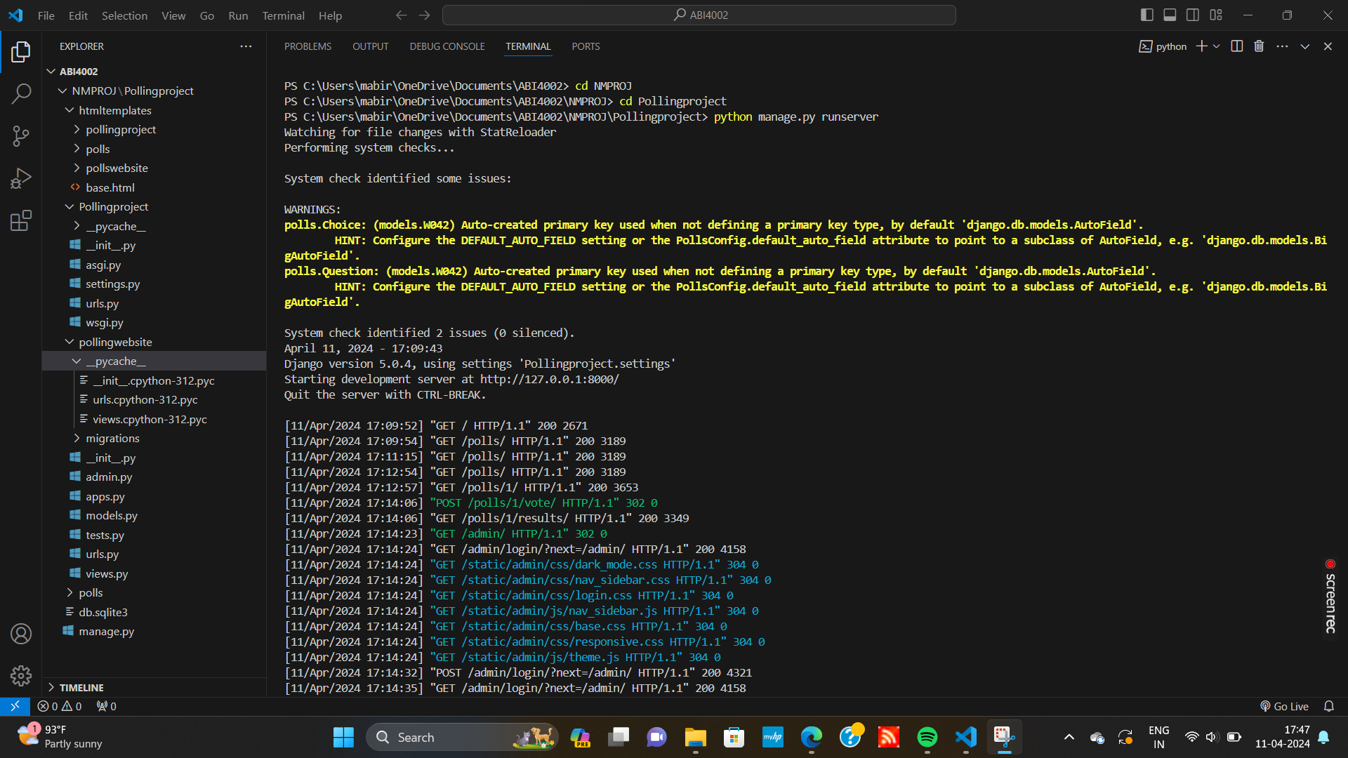
Modelling & Results: Terminals:
Source :

Slide 11
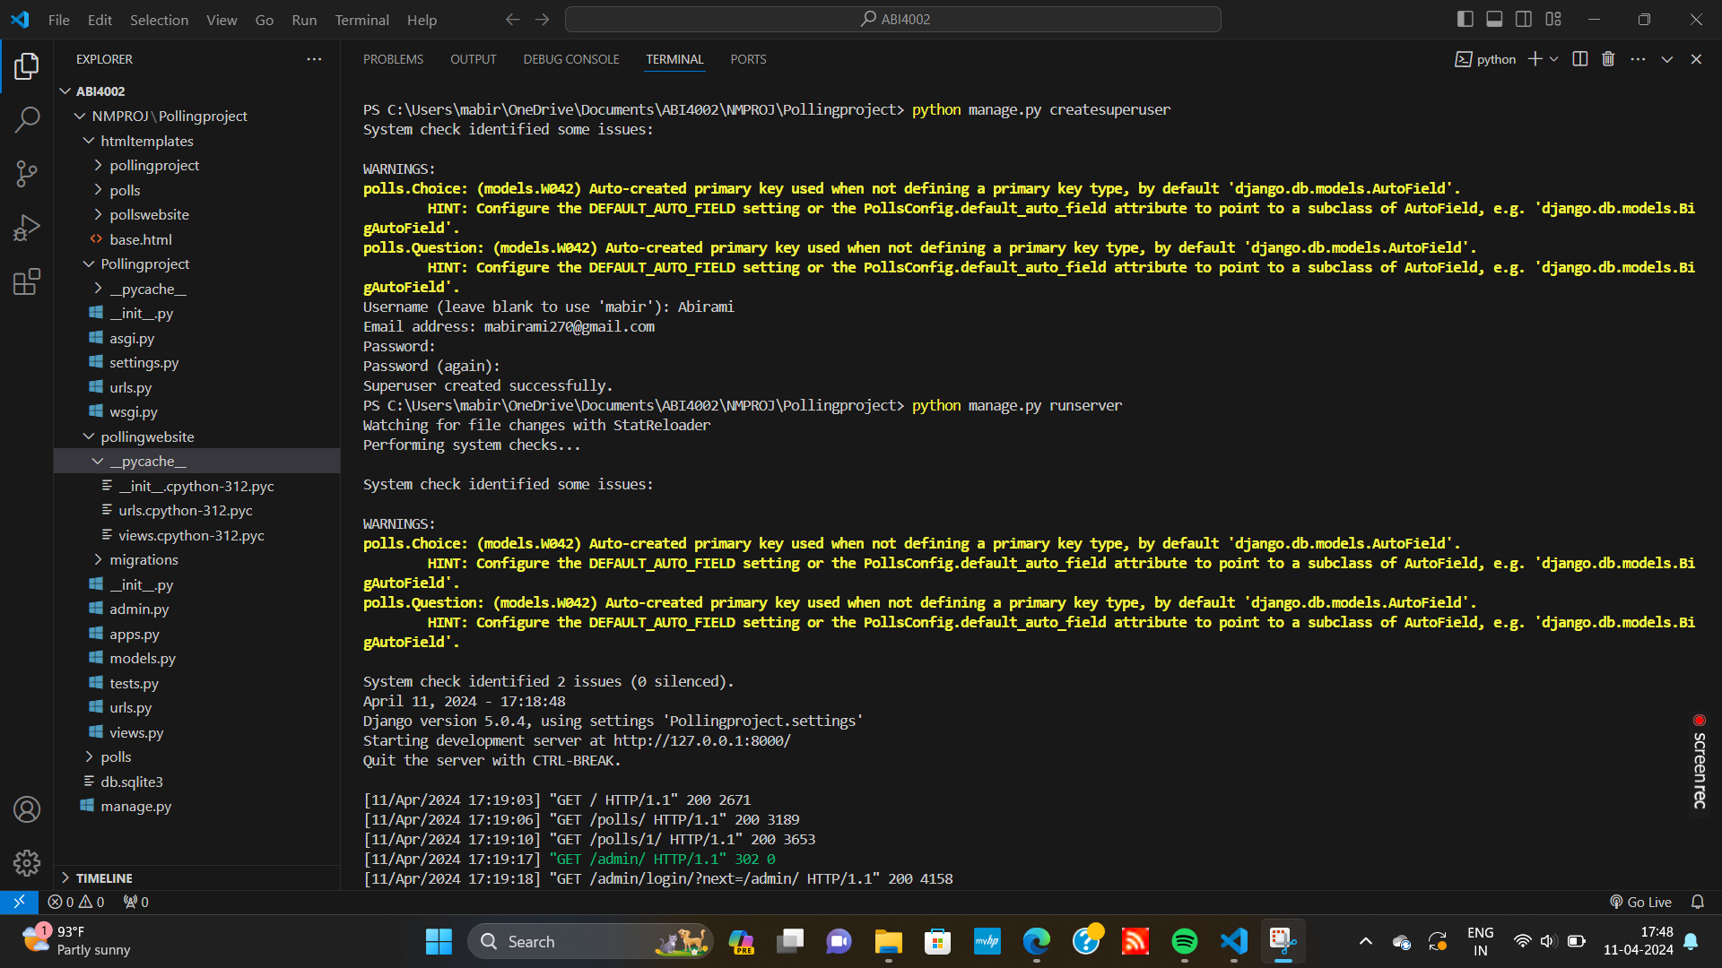
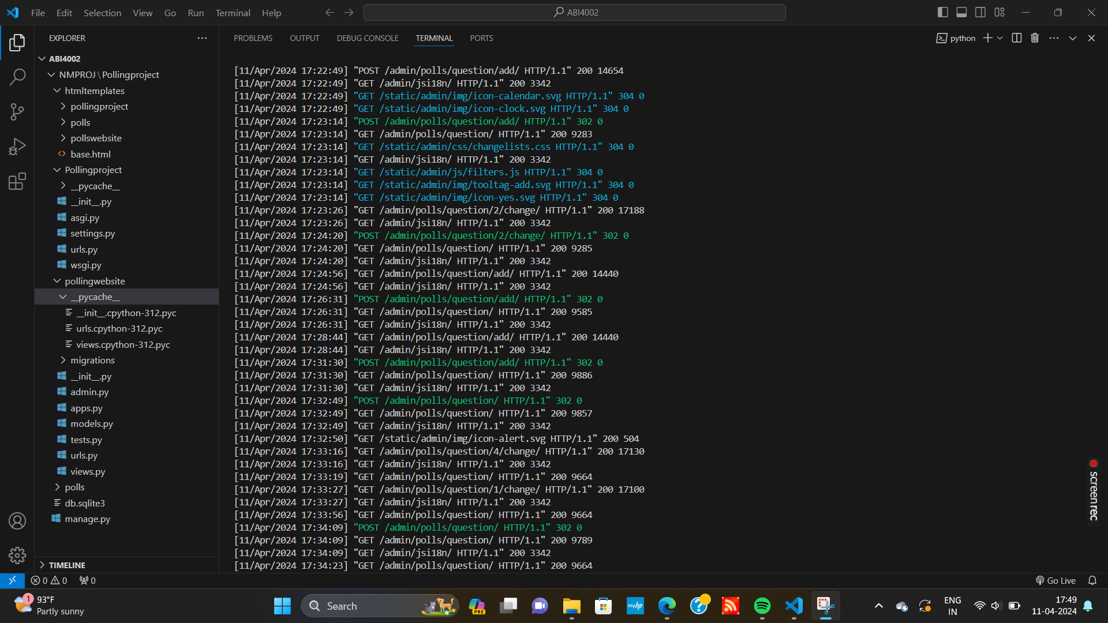
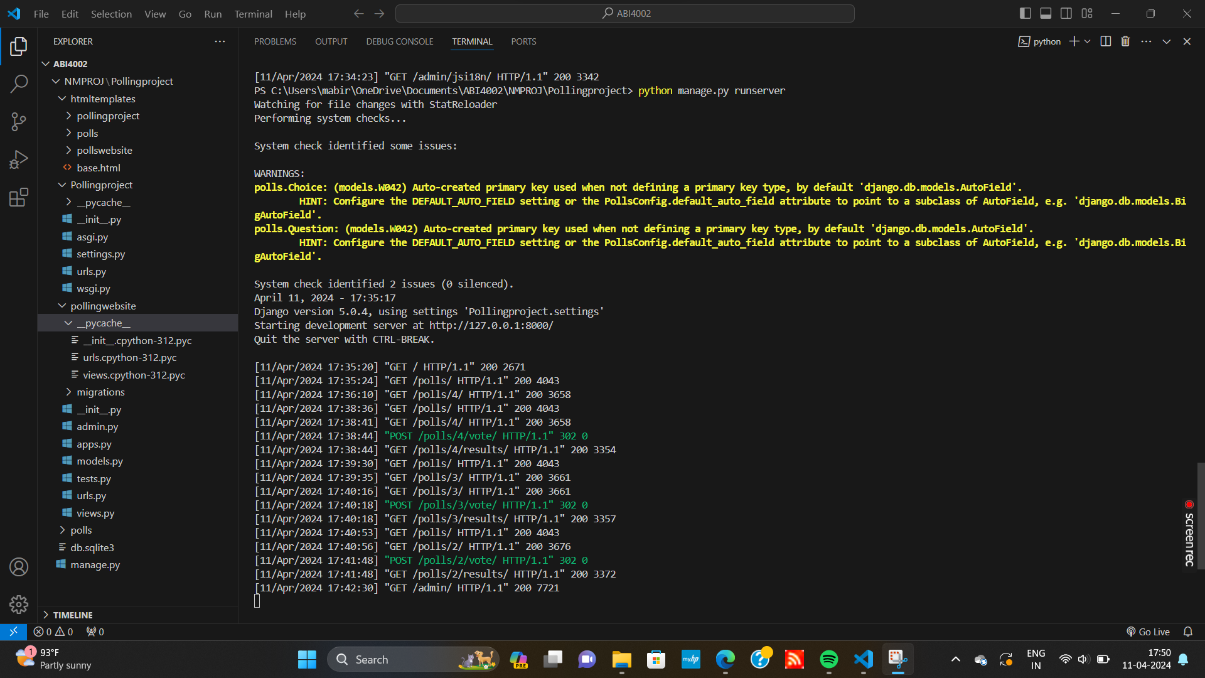

Slide 12
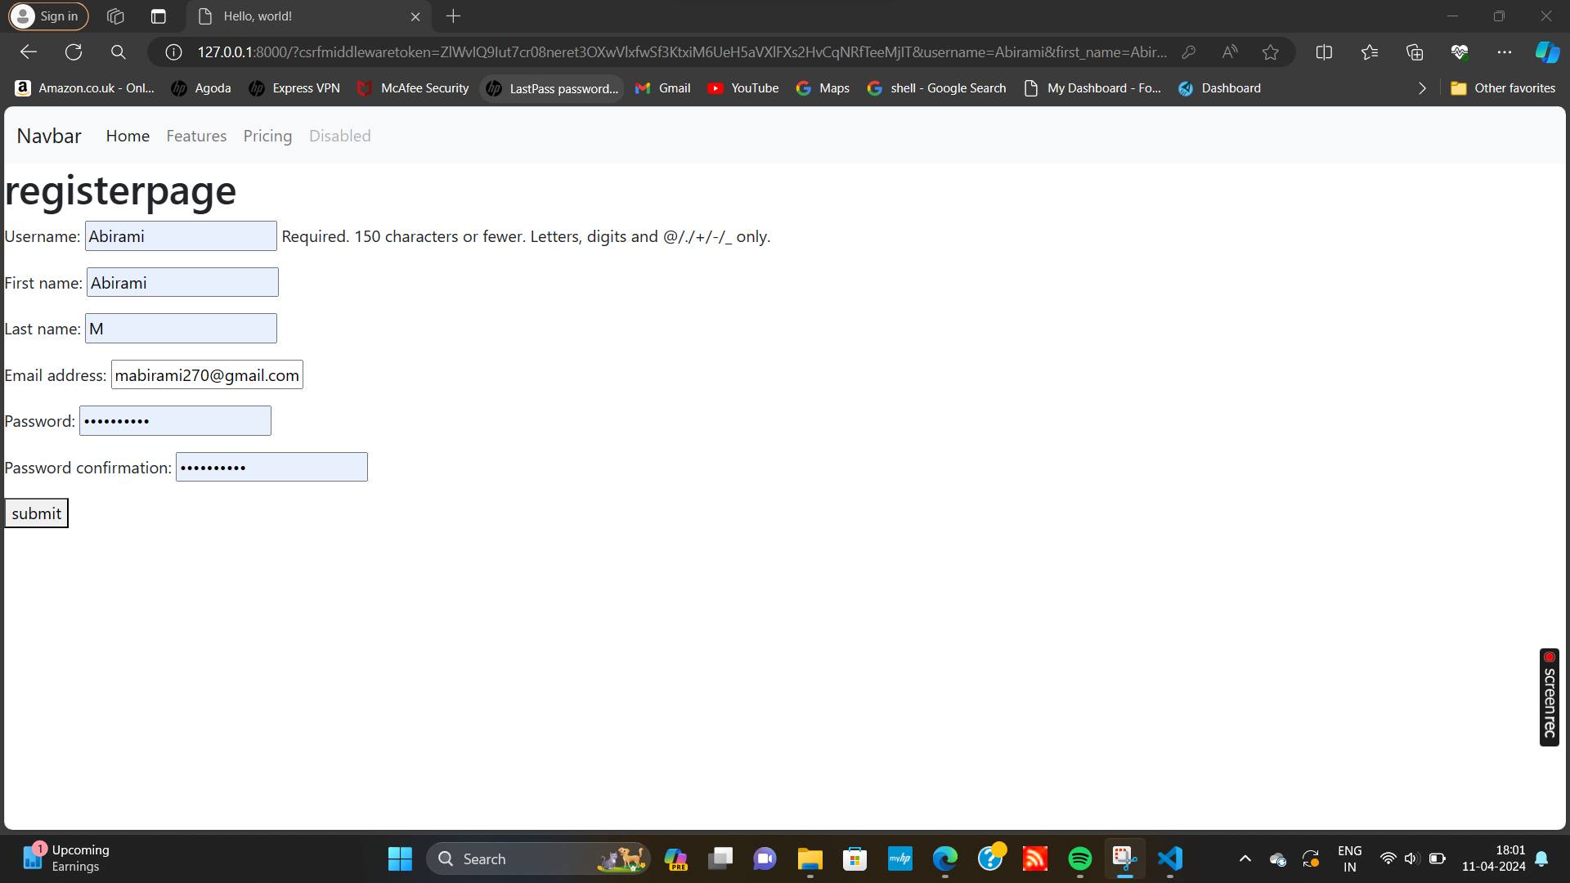
Home page-Register page

Slide 13
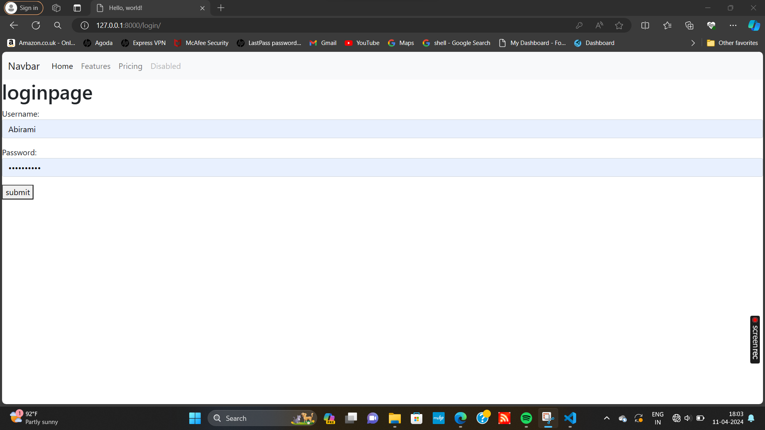
Home page-Login page

Slide 14
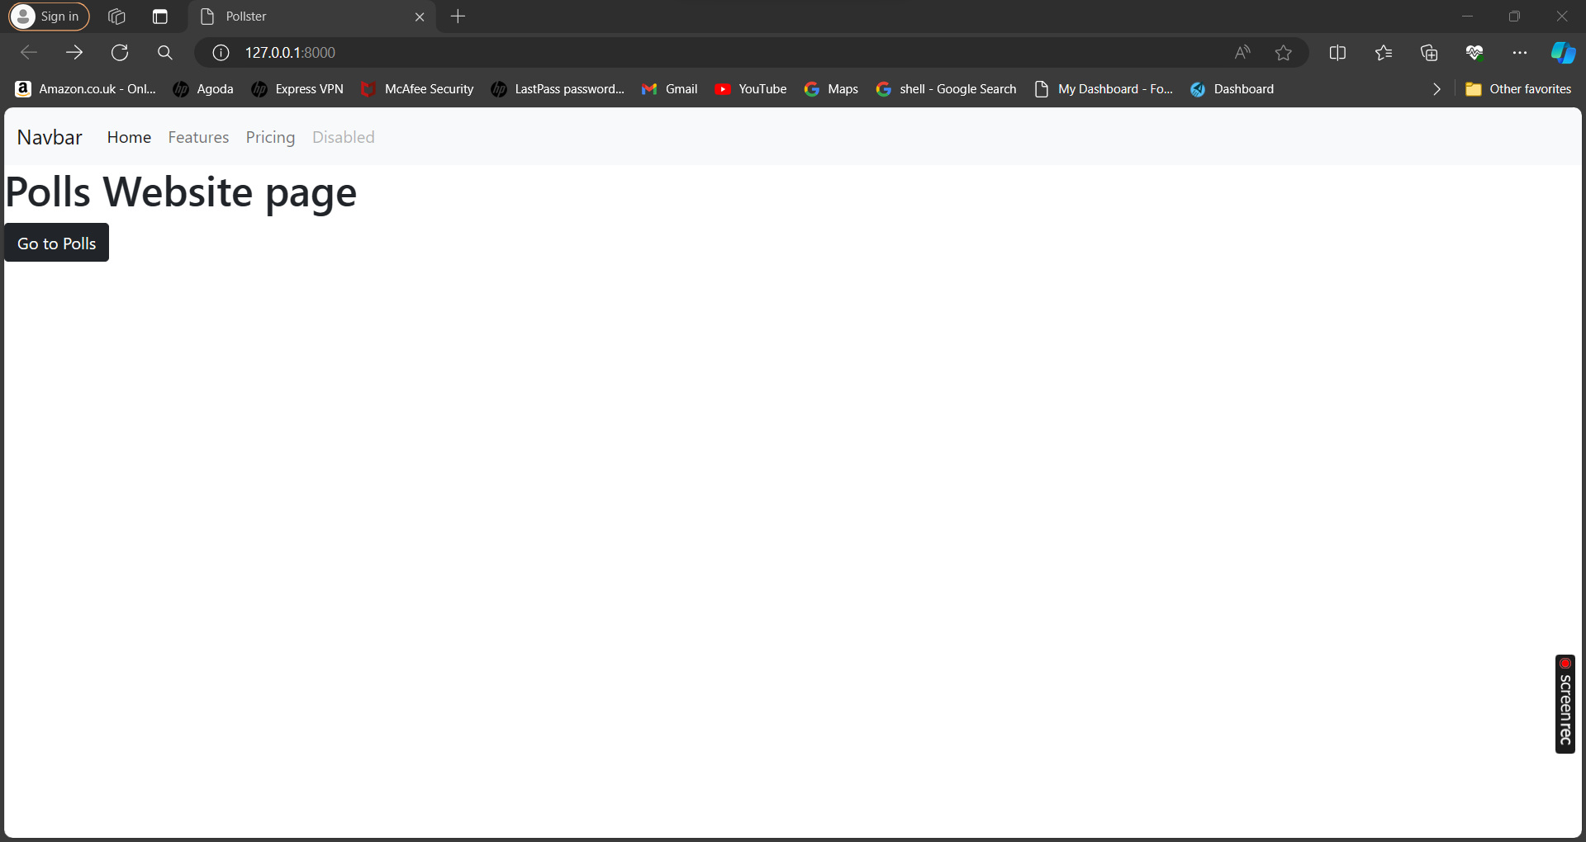
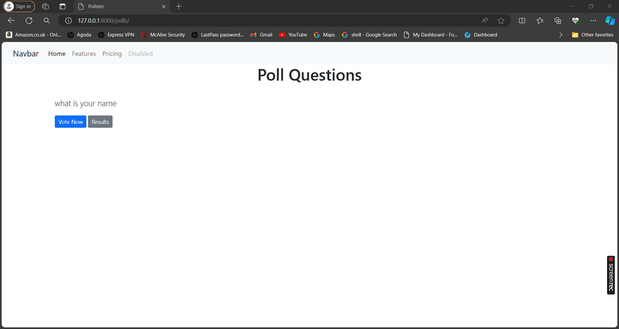
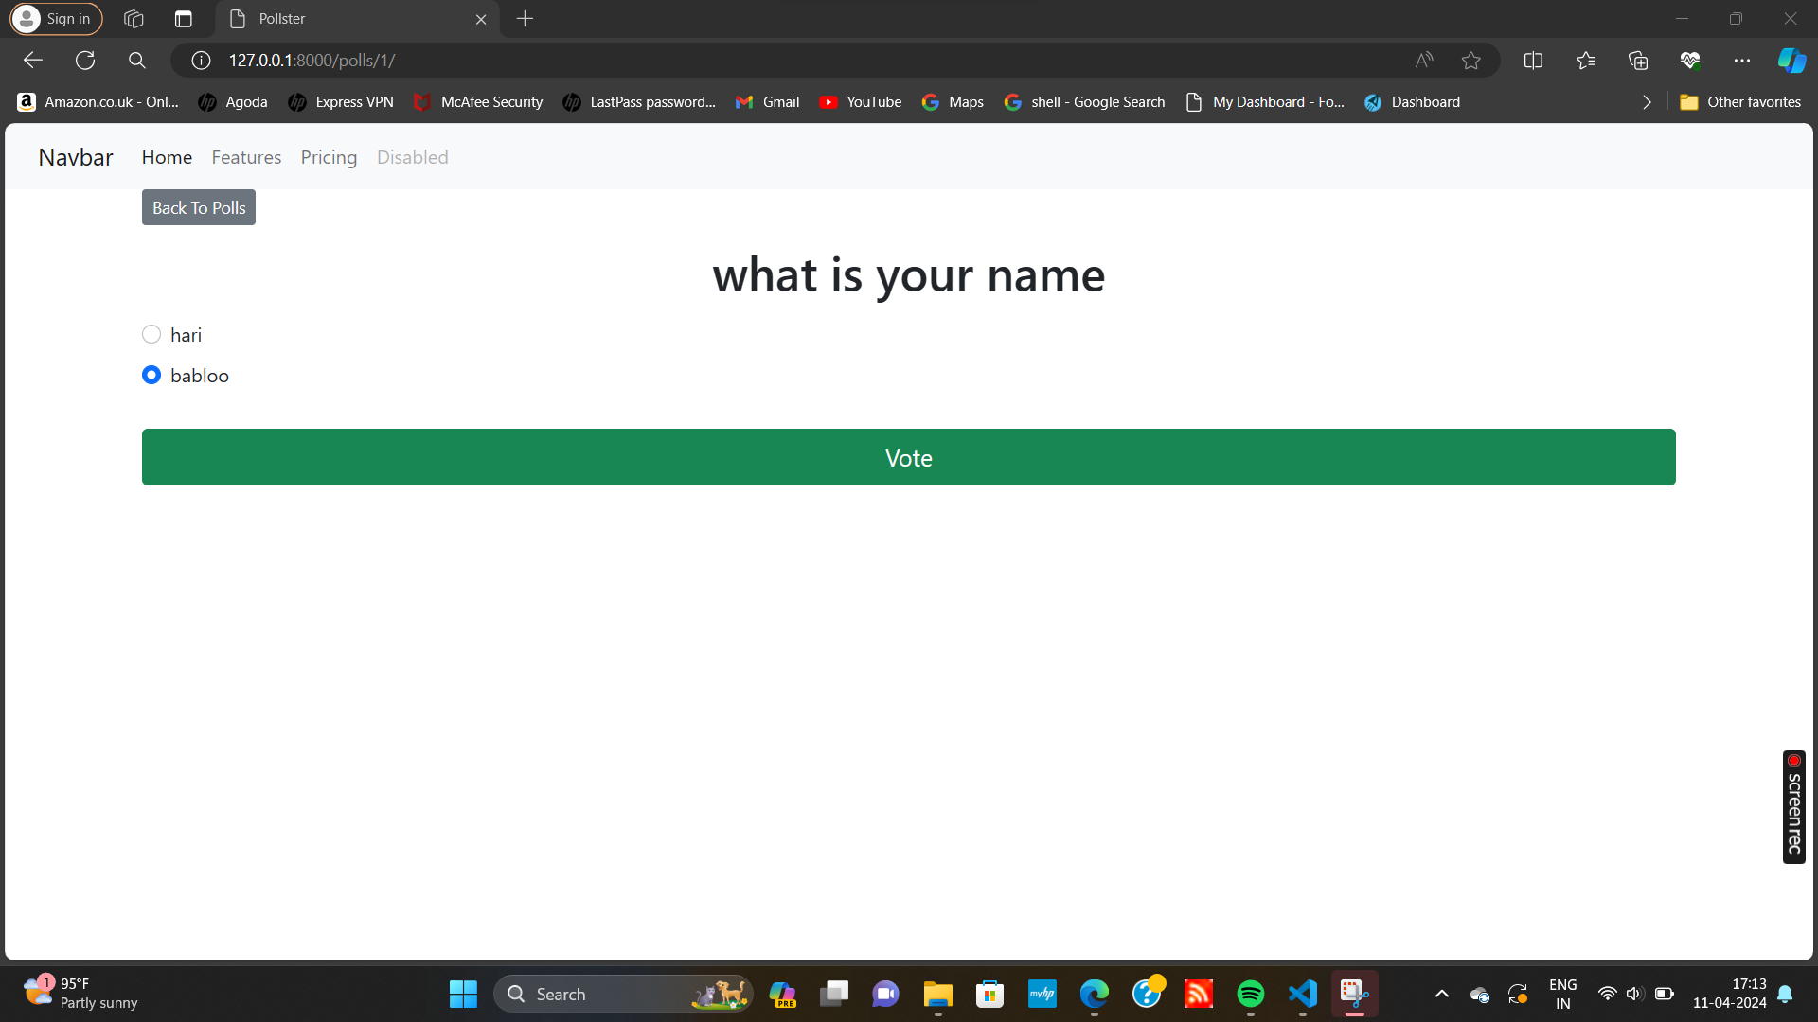
Polls website page

Slide 15
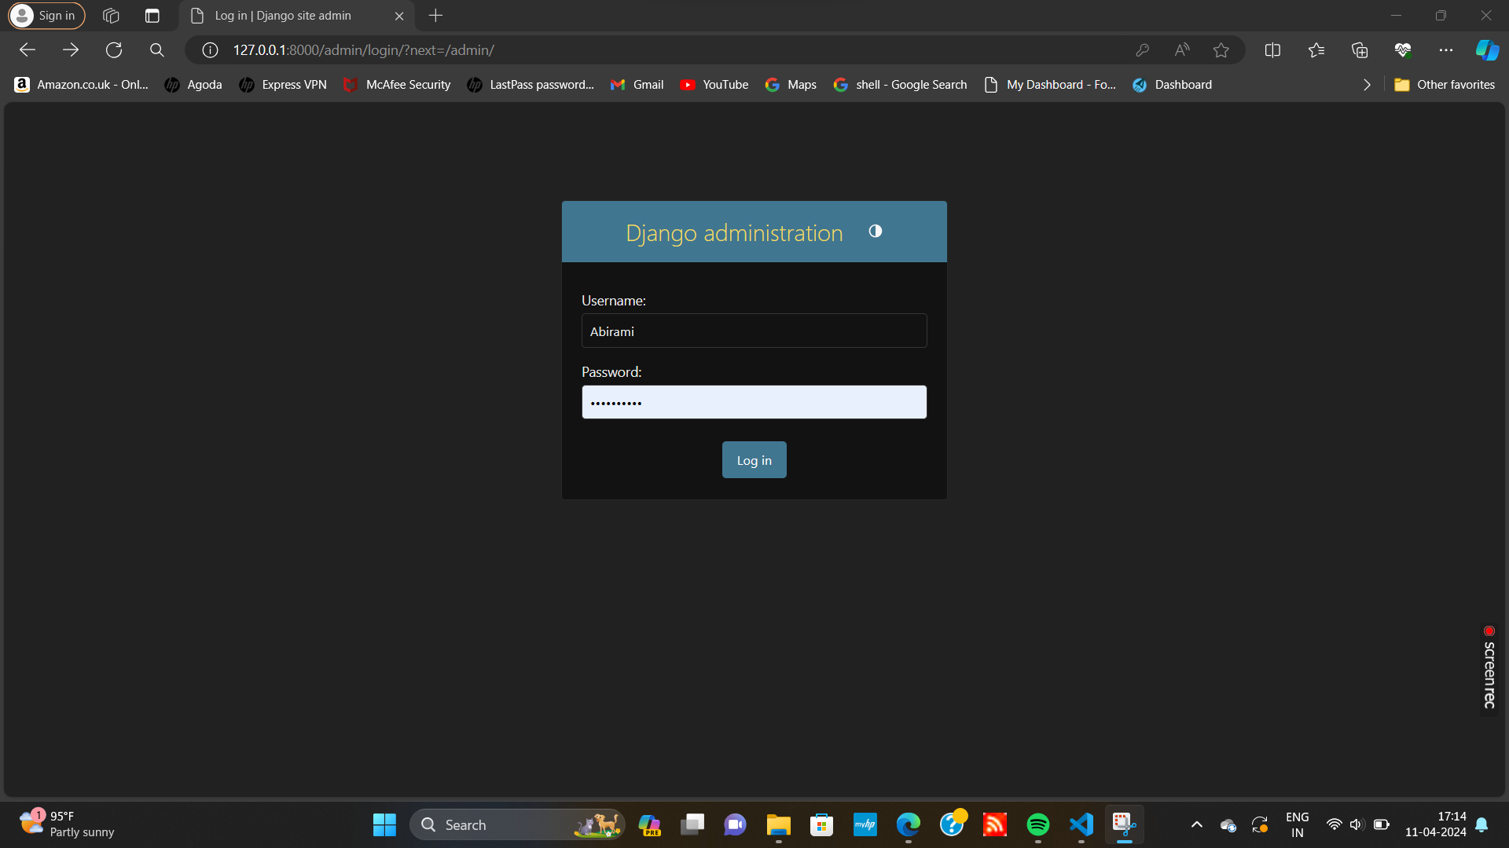
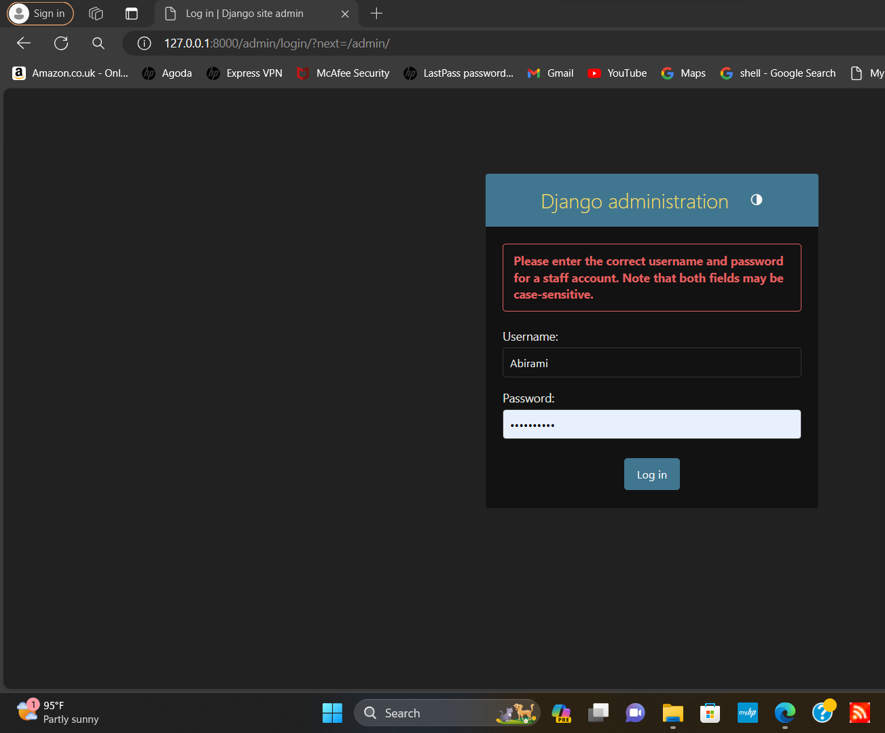
Django administration page

Slide 16
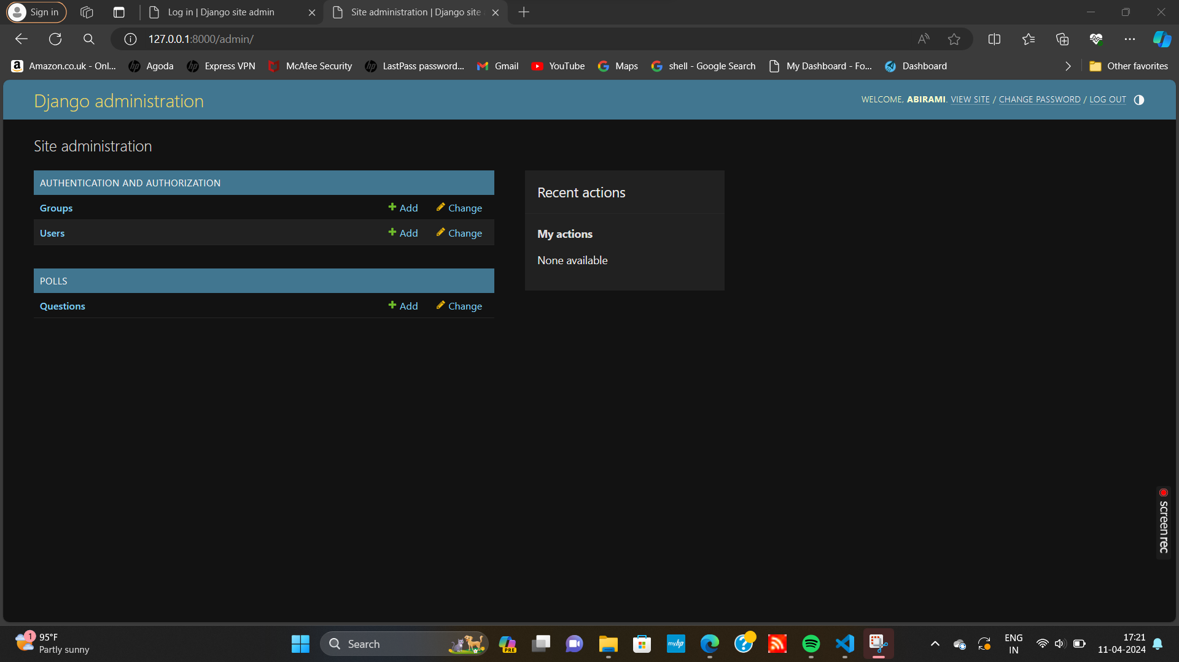
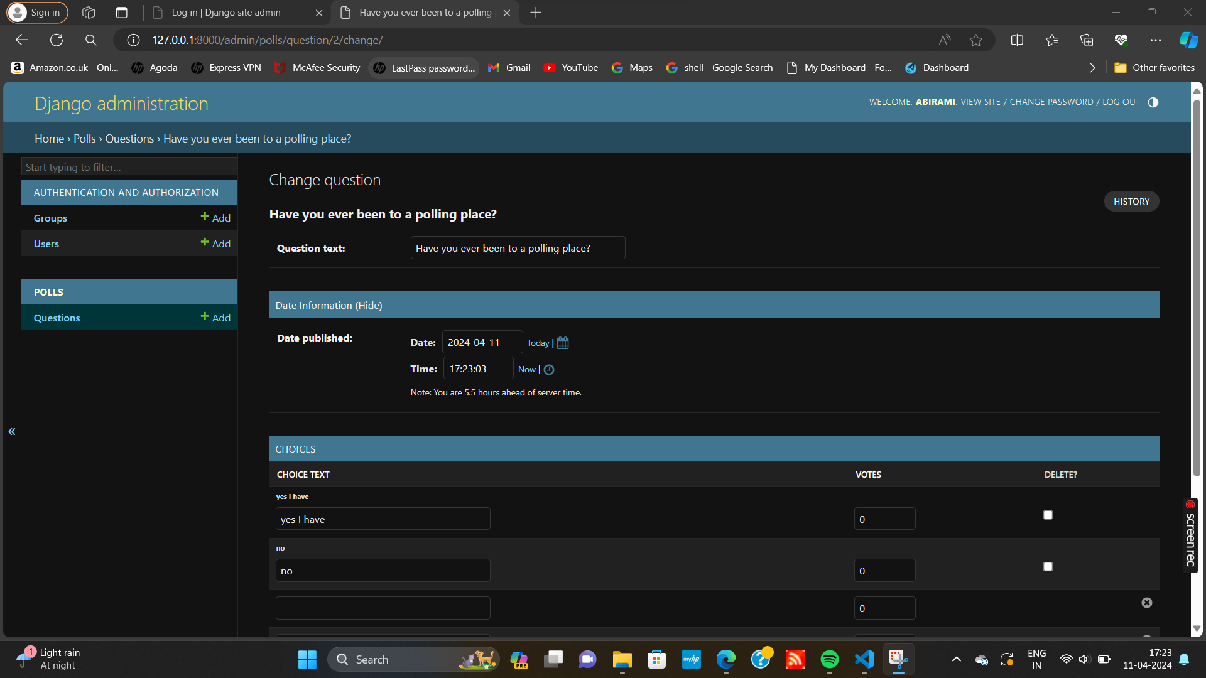

Slide 17
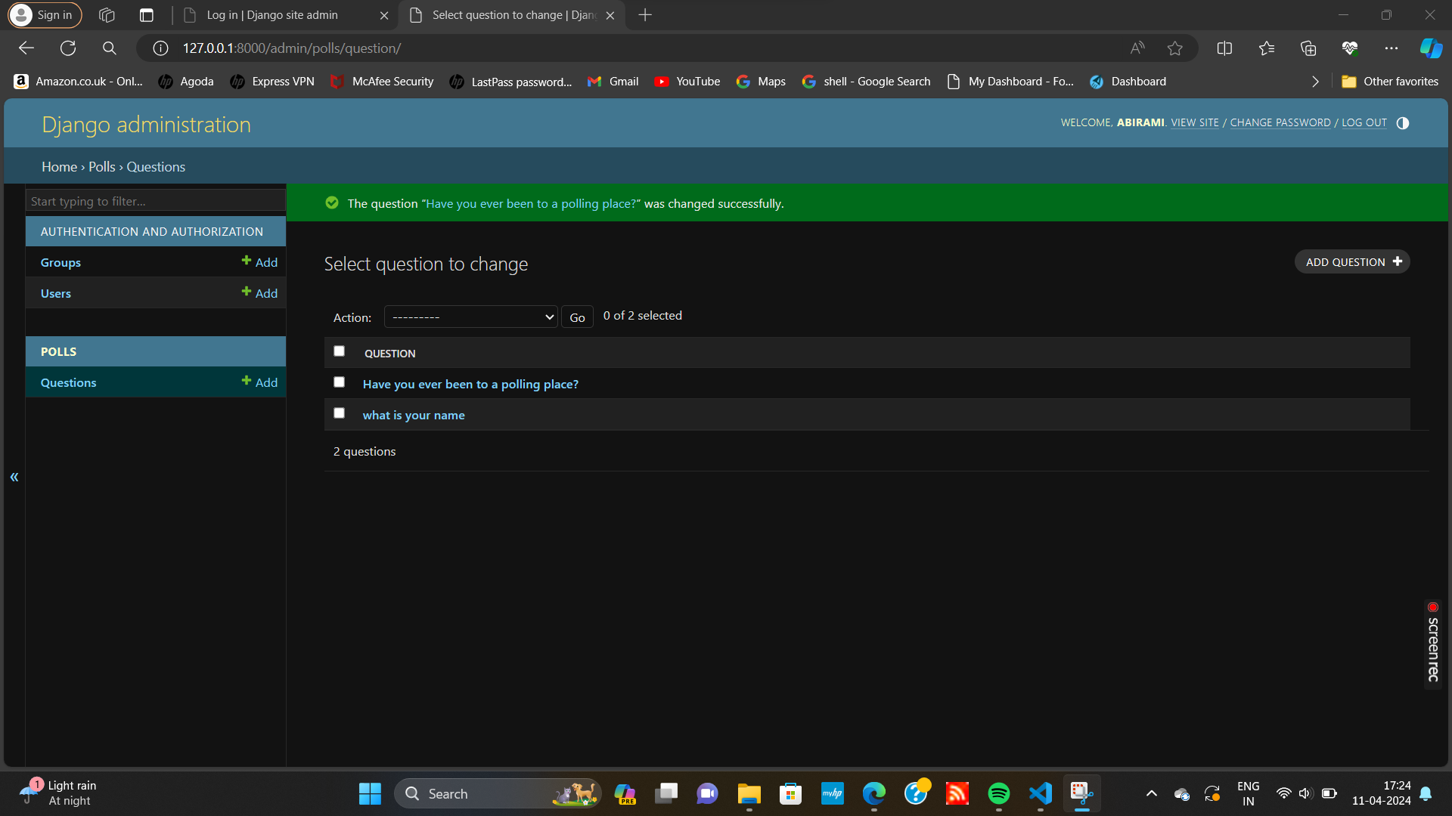
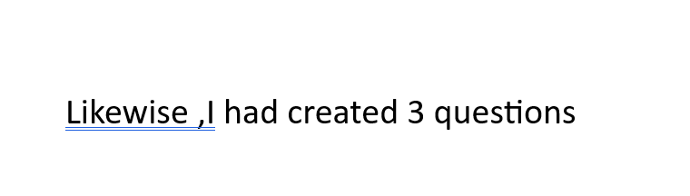

Slide 18
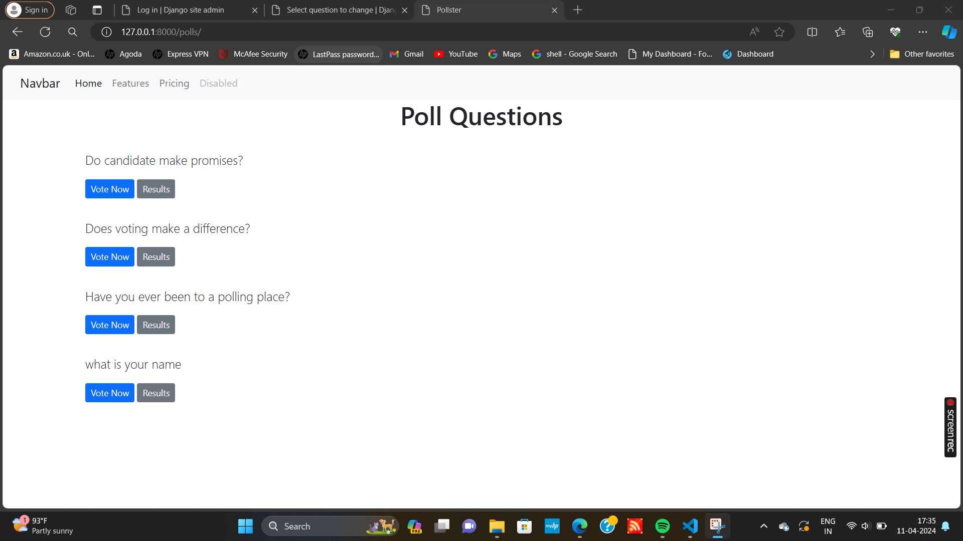
Polling questions-page

Slide 19
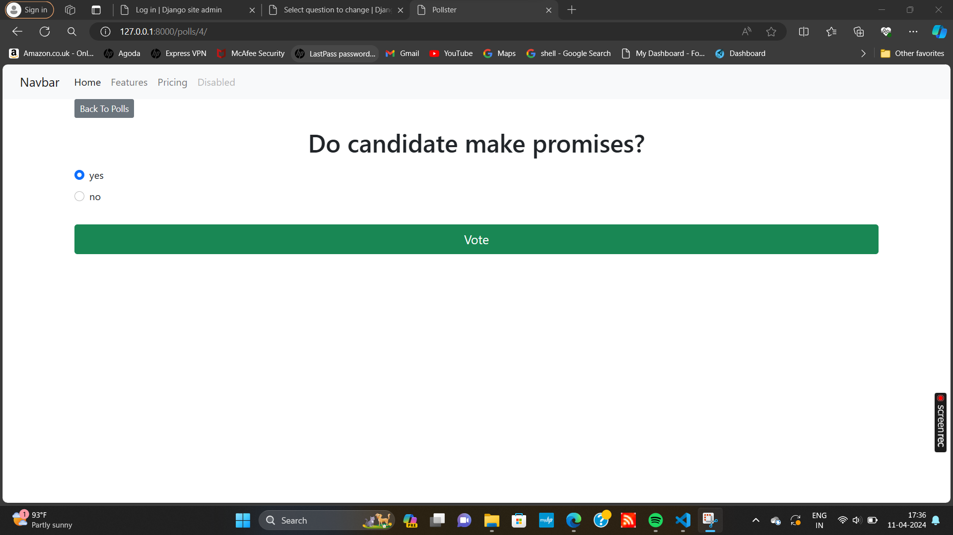
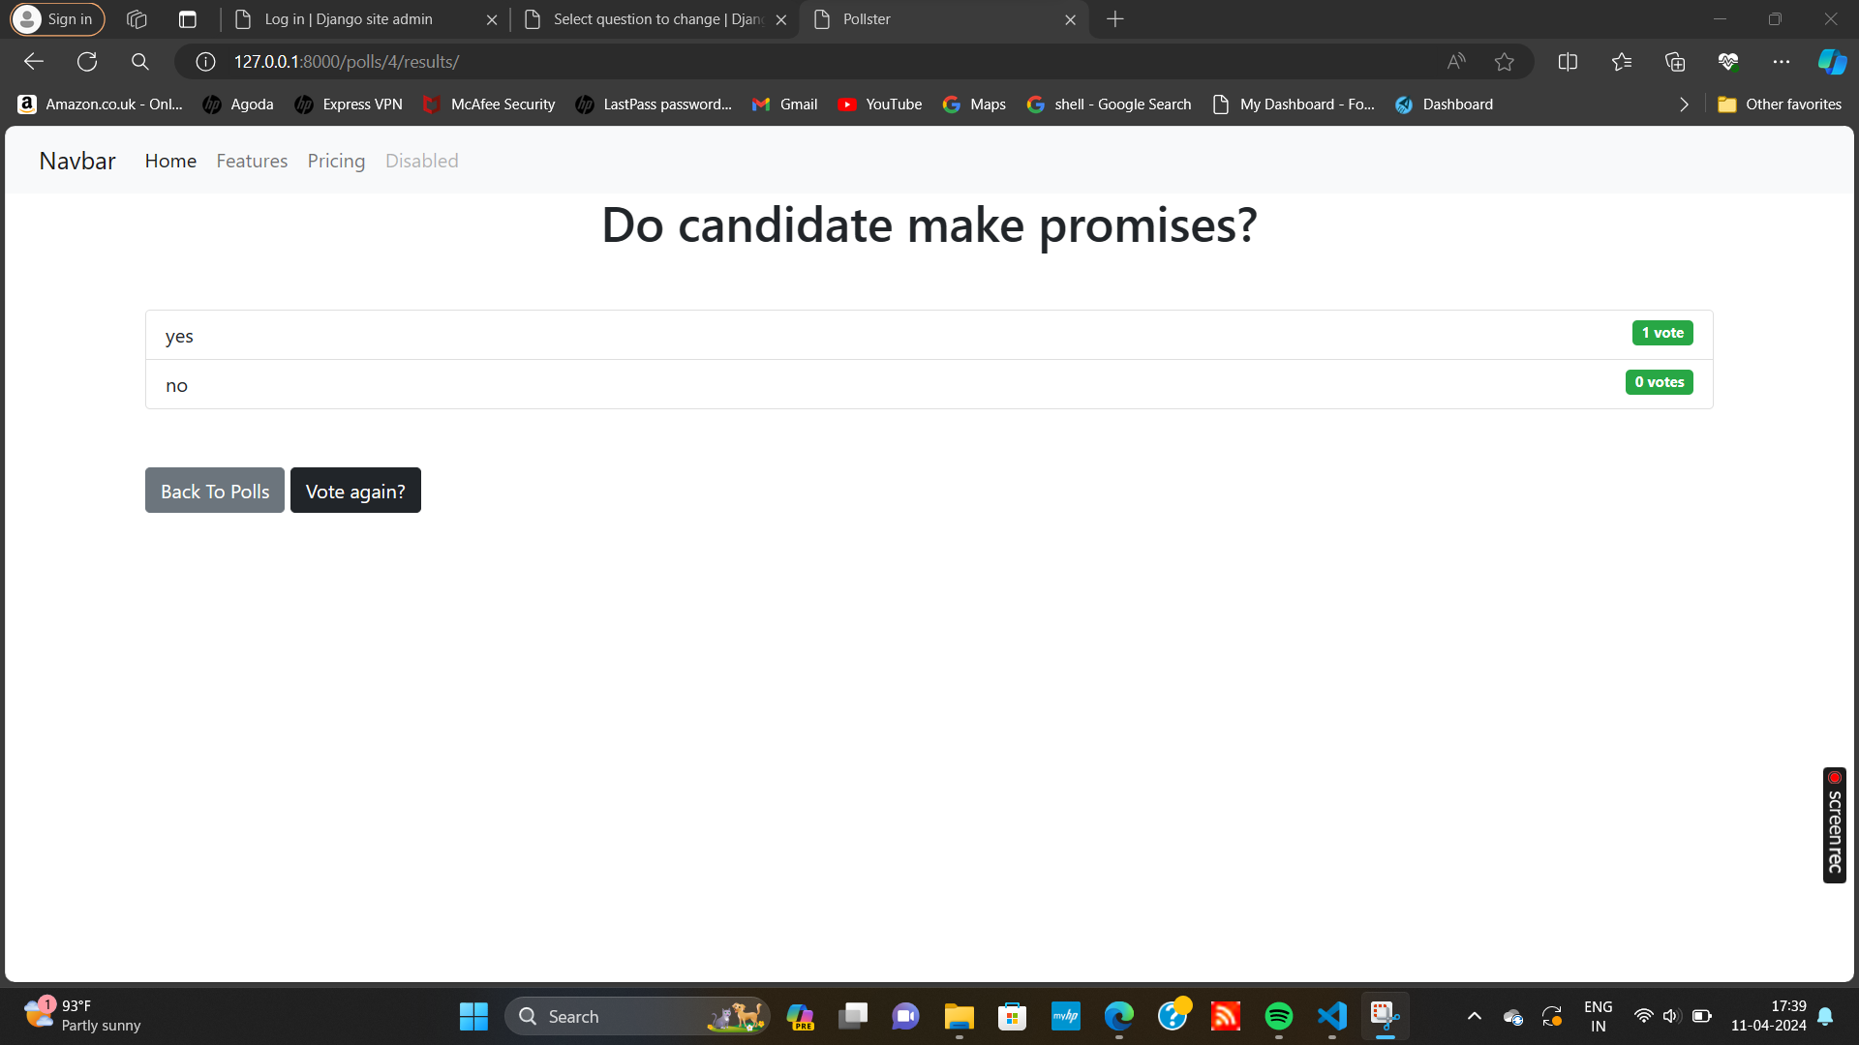
Voting page

Slide 20



Slide 21
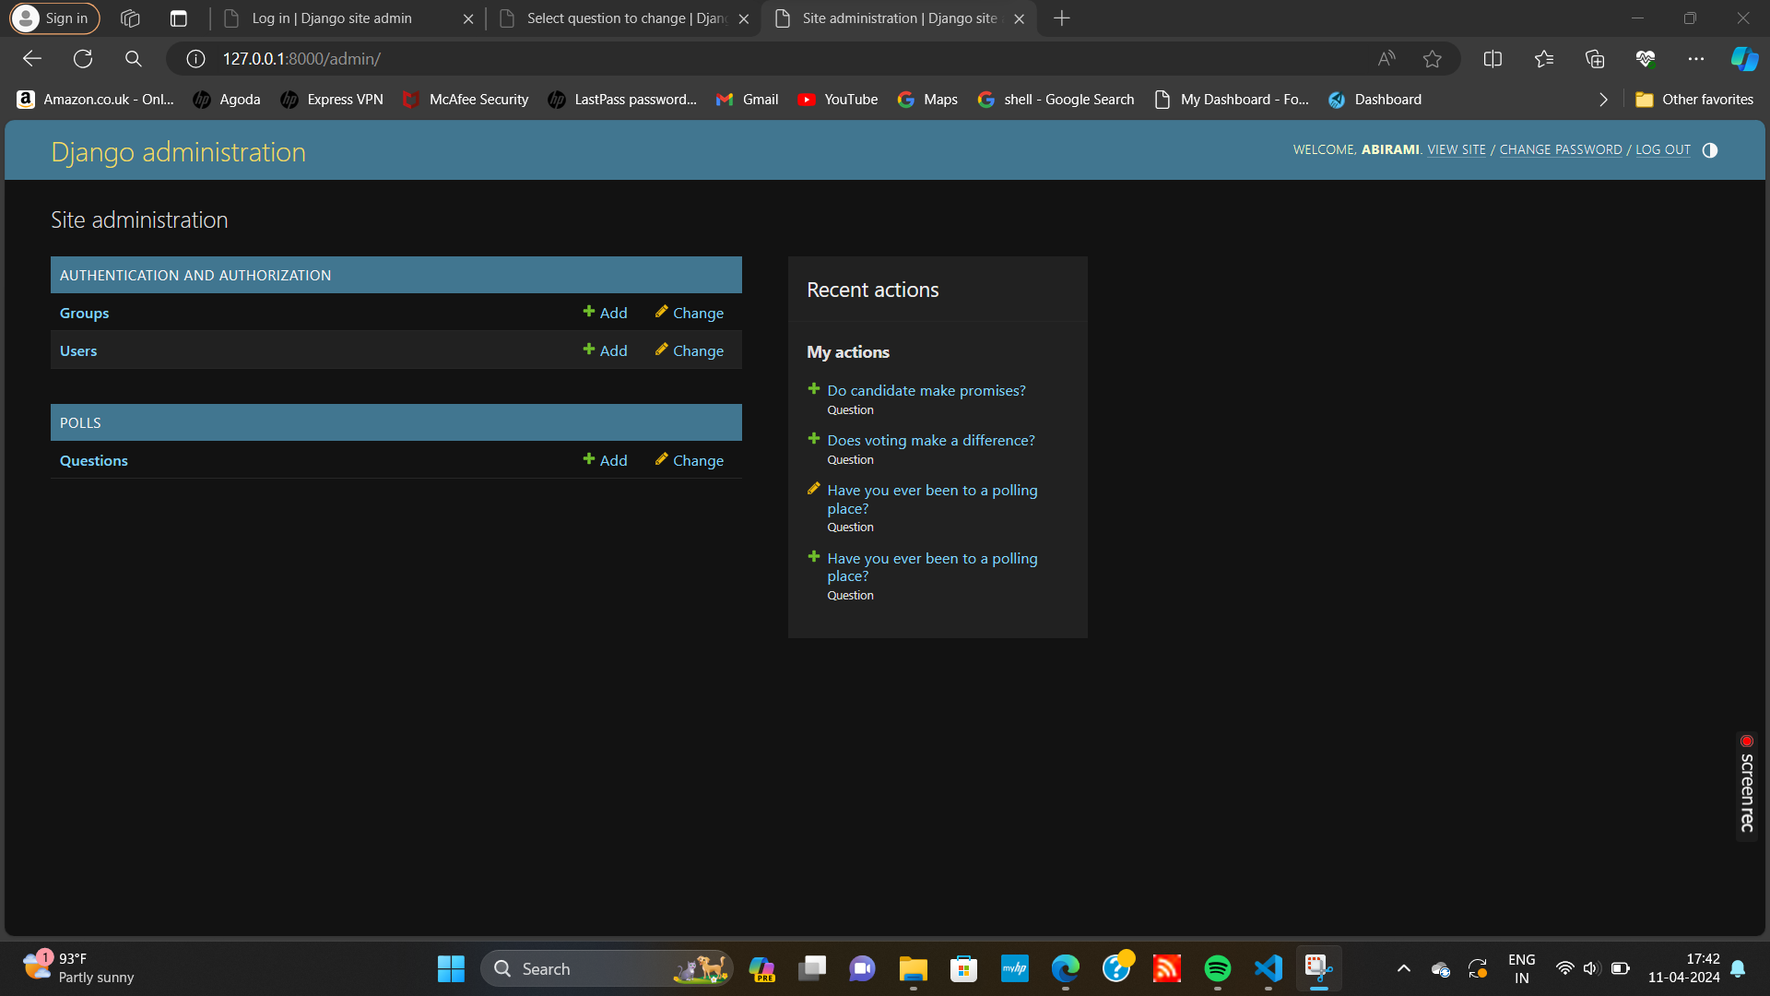
Result-page of my actions in django administration

Slide 22
Conclusion
In conclusion, the Django web application voting system presents a comprehensive and effective solution for modernizing the electoral process. By leveraging the Django framework's flexibility and security features, the system offers a user-friendly interface for both voters and administrators, ensuring accessibility and transparency in elections.
Through robust user authentication, secure ballot creation, and advanced voting mechanisms, the system enhances the integrity and efficiency of the voting process. Real-time result tabulation and audit trails further contribute to the system's reliability and accountability.
Overall, the Django web application voting system represents a significant step forward in democratizing elections, enabling broader participation and ensuring the integrity of the democratic process.
Source :

Slide 23
Thank You!
Notes:
Thank You !!

